Slide 1
Numerical Programming
Zhongshan Xu
2021/01/04

Slide 2
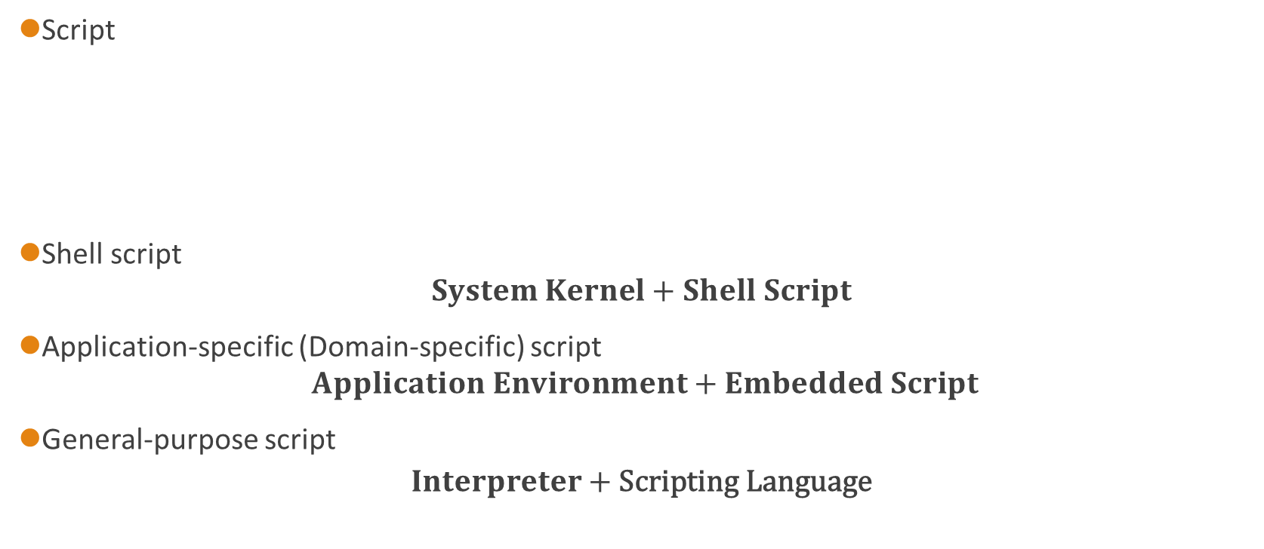
What is Scripting（脚本）language?
Script
Shell script
$$System Kernel+Shell Script$$
Application-specific (Domain-specific) script
$$Application Environment+Embedded Script$$
General-purpose script
$$Interpreter+\text{S}\text{cripting} \text{L}\text{anguage}$$
Script
Call
API1
API2
…

Slide 3
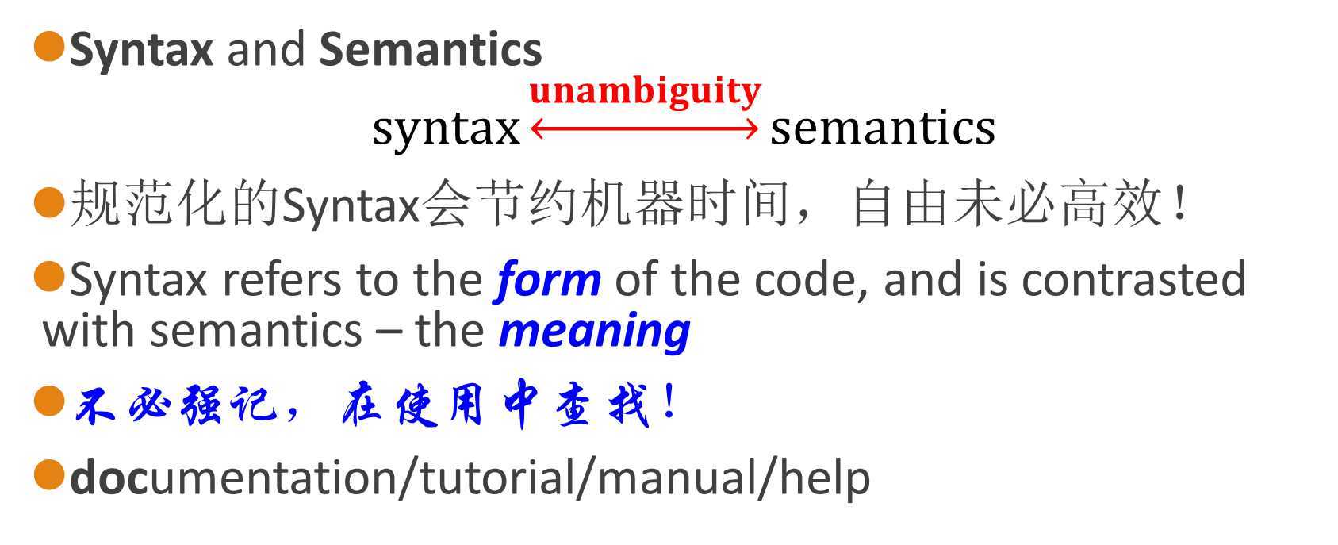
Syntax（句法）
Syntax and Semantics
$$syntax\underset{↔}{unambiguity}semantics$$
规范化的Syntax会节约机器时间，自由未必高效！
Syntax refers to the form of the code, and is contrasted with semantics – the meaning
不必强记，在使用中查找！
documentation/tutorial/manual/help

Slide 4
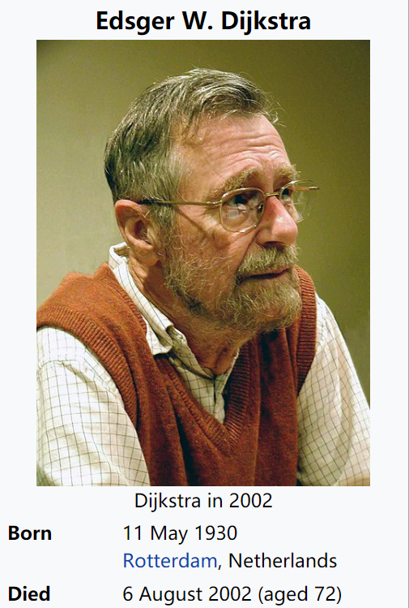
Programming Paradigm（范式）
Non-structured versus Structured
(Structured) Programming paradigm
Object-Oriented
Method
Data
Functional
Function(callable unit)
Procedural
Sequence(line)
Repetition(loop)
Selection(branch)

Slide 5
Array paradigm
data structure is the array
generalizing operations on scalars to apply transparently to vectors, matrices, and higher-dimensional arrays
vectorized code
implicit parallelization
省却了遍历循环（for loop）
避免使用Procedural paradigm，优先考虑Array paradigm!

Slide 6
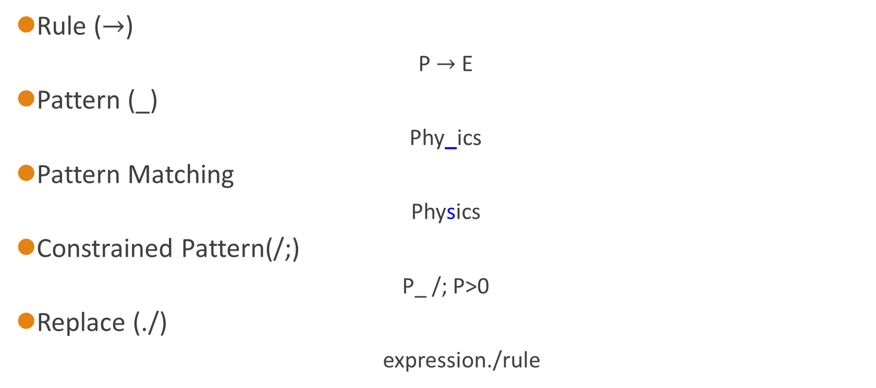
Rule-based paradigm
Mathematica is a rule-based engine
Rule ($→$)
P $→$ E
Pattern (_)
Phy_ics
Pattern Matching
Physics
Constrained Pattern(/;)
P_ /; P>0
Replace (./)
expression./rule

